Slide 1
Big-O notation
Big O notation is used in Computer Science to describe the performance or complexity of an algorithm. Big O specifically describes the worst-case scenario, and can be used to describe the execution time required or the space used (e.g. in memory or on disk) by an algorithm.

Slide 7
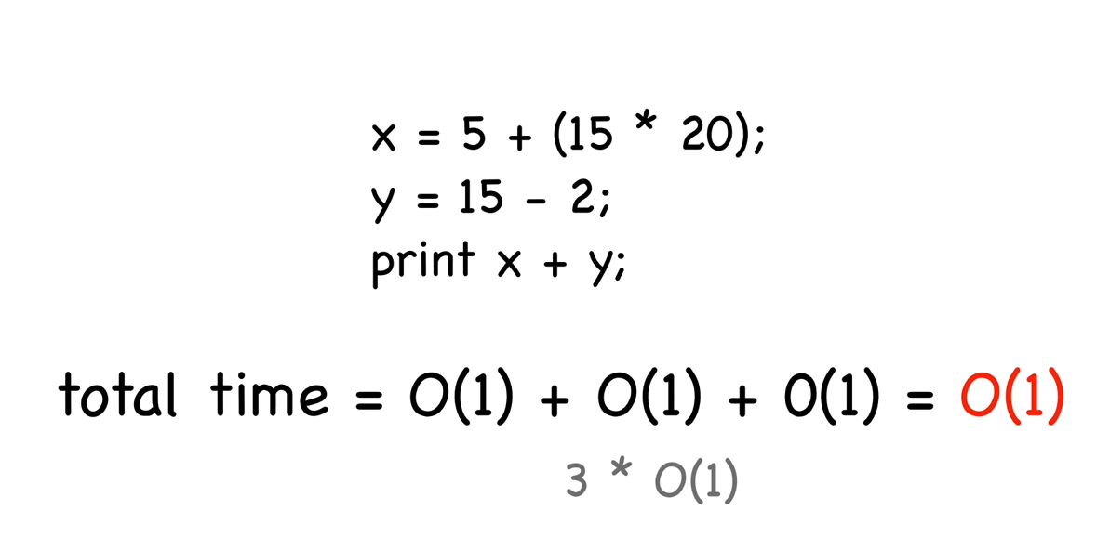

Slide 8
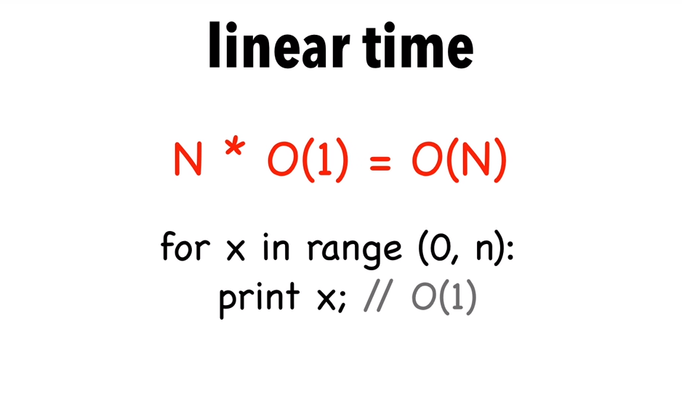

Slide 9
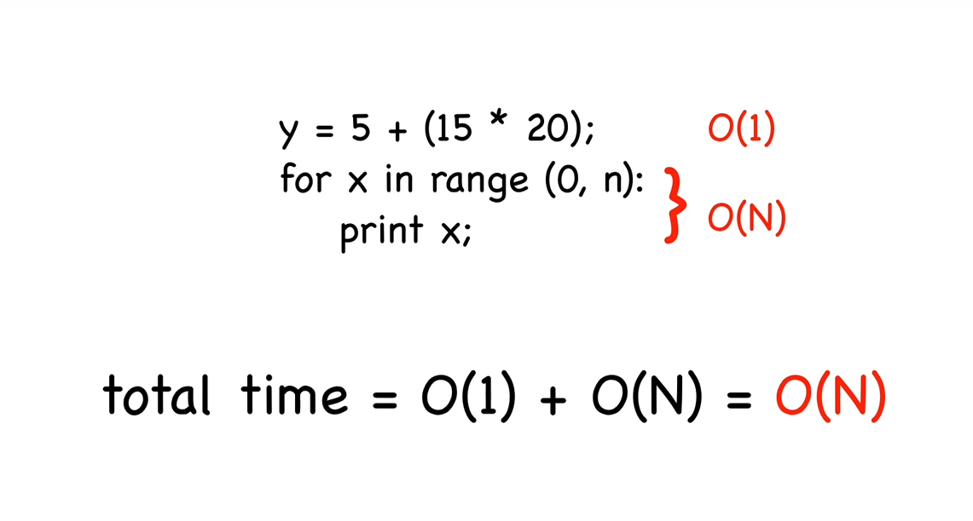

Slide 10
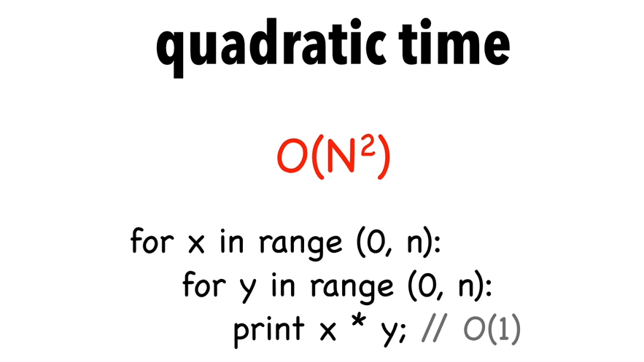

Slide 11
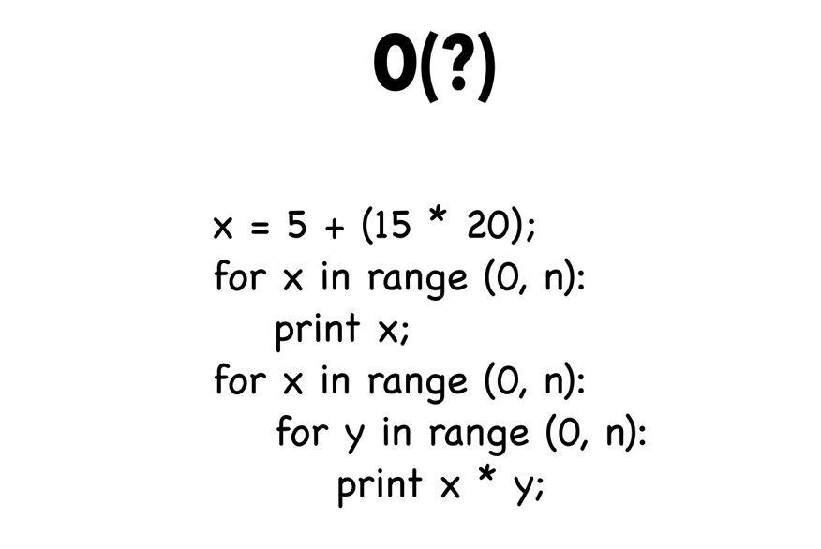

Slide 12
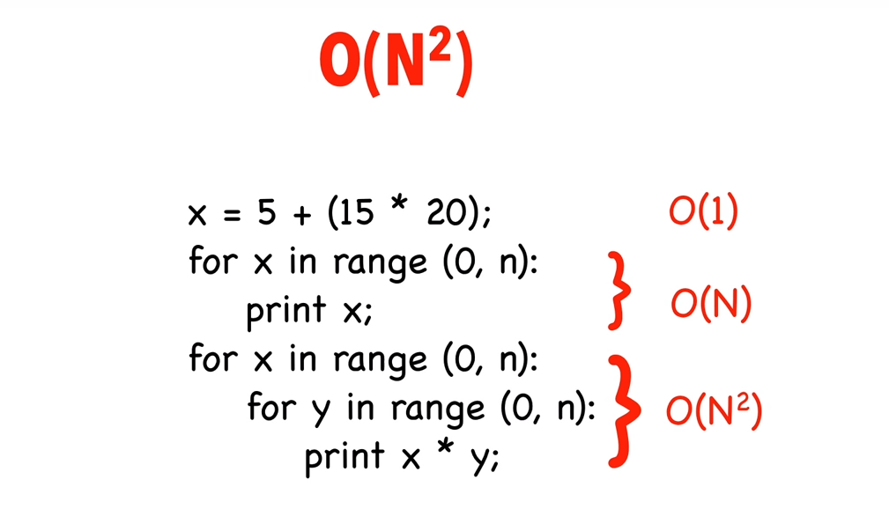

Slide 13
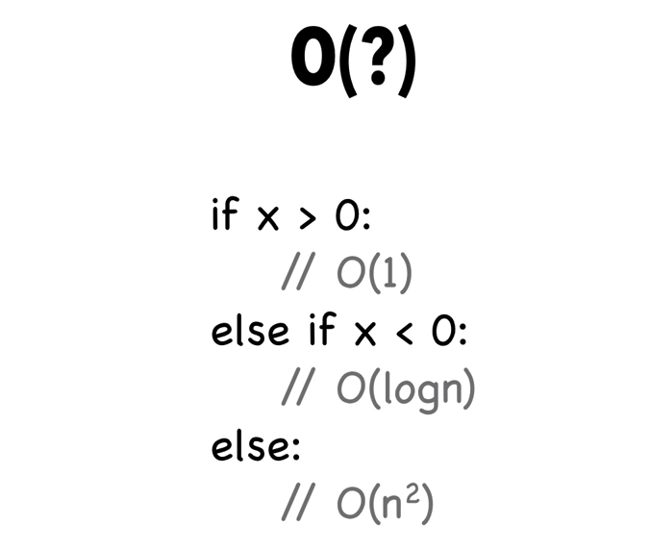

Slide 14
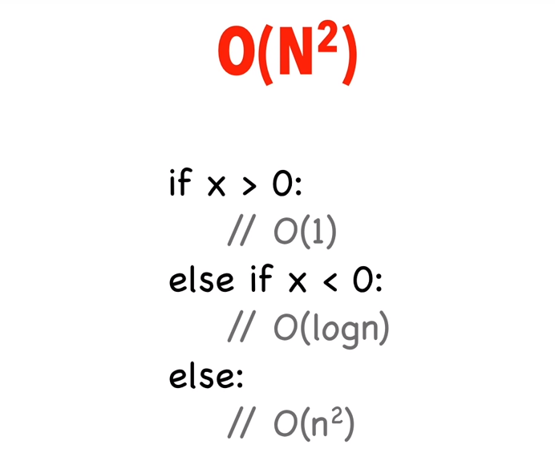

Slide 15
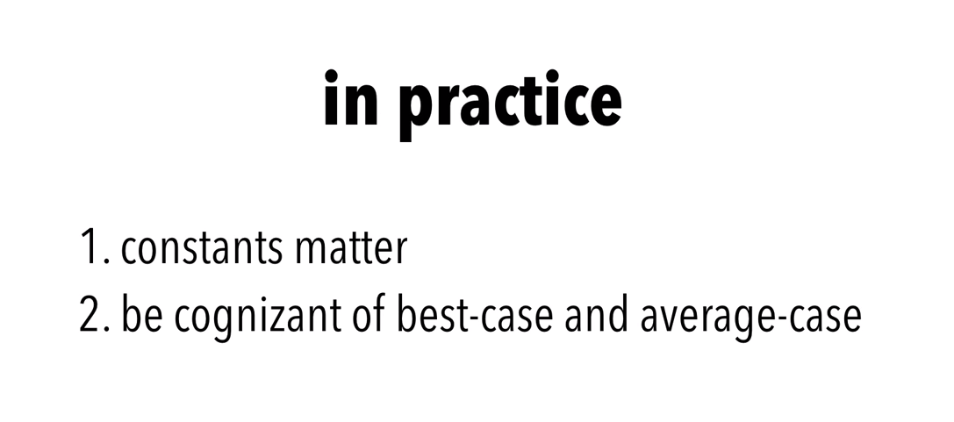

Slide 16
Case Study
Sum of n natural numbers :
int findSum(int n)
{
int sum = 0;
for (int x=1; x<=n; x++)
sum = sum + x;
return sum;
}
O(?)
Sum of n natural numbers :
int findSum(int n)
{
int sum = 0;
sum = n*((n+1)/2);
return sum;
}
O(?)

Slide 17
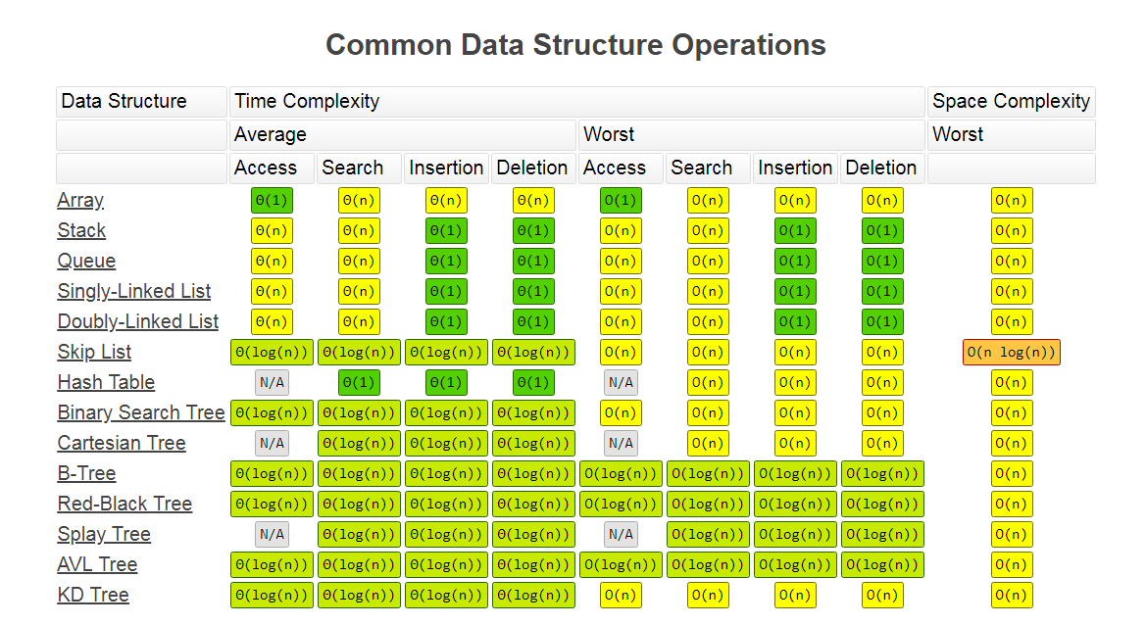

Slide 18
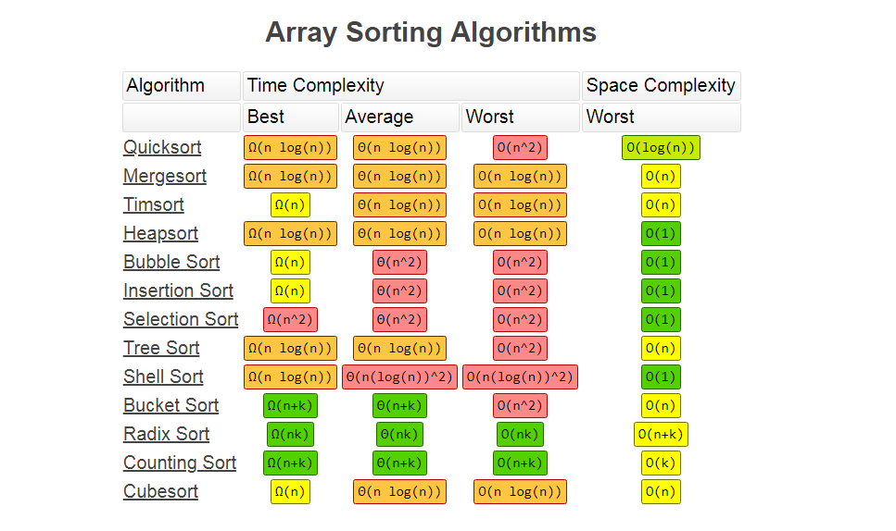

Slide 19
Reference Link
http://cooervo.github.io/Algorithms-DataStructures-BigONotation/big-O-notation.html

